Slide 1
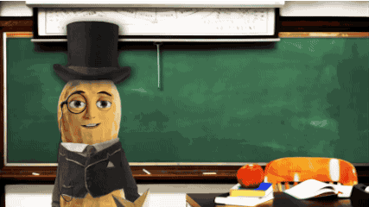
Who’s he?

Slide 2
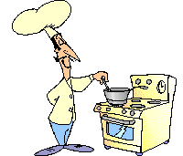
c
o
o
k

Slide 3
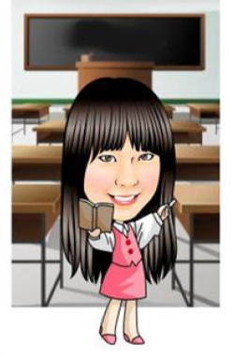
t
e
a
c
h
e
r

Slide 4
s
t
u
d
e
n
t

Slide 5
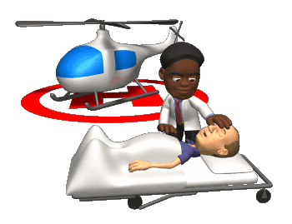
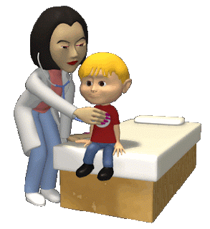
d
o
c
t
o
r

Slide 6
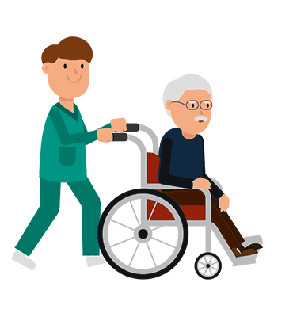
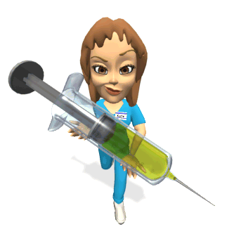
n
u
r
s
e

Slide 7
Is she a student?
Yes, she is.

Slide 8
Is he a cook?
No, he isn’t.
He’s a doctor.

Slide 9
Is she a nurse?
No, she isn’t.
She’s a singer.

Slide 10
Are you a doctor?
Yes, I am.

Slide 11
Is he a teacher?
No, he isn’t.
He’s a president.

Slide 12
Is he a student?
Yes, he is.

Slide 13
Is he a doctor?
No, he isn’t.
He’s a super hero.

Slide 14
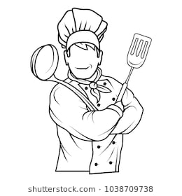
Are you a nurse?
No, I’m not.
I’m a cook.

Slide 15
Is she a cook?
No, she isn’t.
She’s a princess.

Slide 16
Is he a teacher?
Yes, he is.

Slide 17
Yes, I am.
Yes, he is.
Yes, she is.
No, I’m not.
No, he isn’t.
(he’s not)
No, she isn’t.
(she’s not)
Yes簡答不可以縮寫

Slide 18
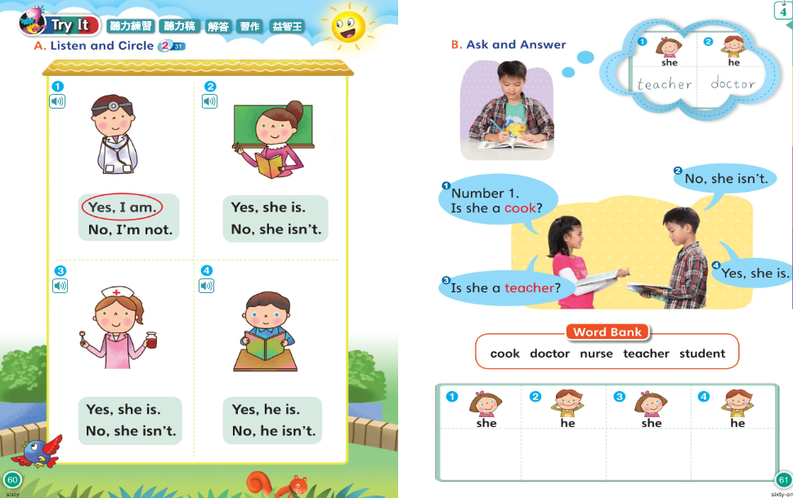

Slide 20
Where is Dino?
2.What do you see on the wall?
3.Who collect the old things?

Slide 21
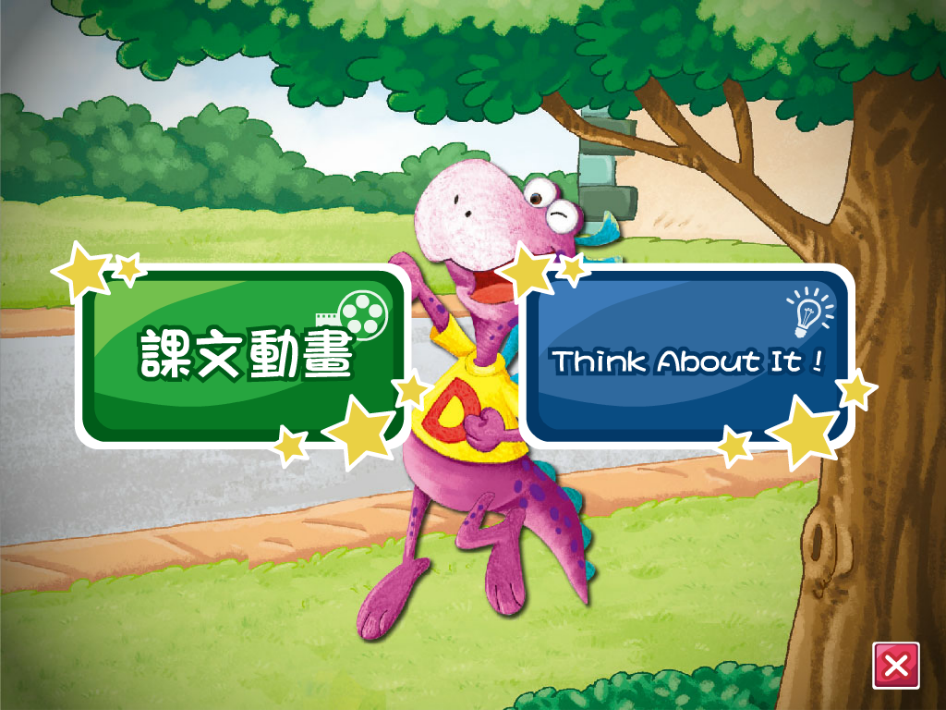

Slide 22
朋友
太太

Slide 23
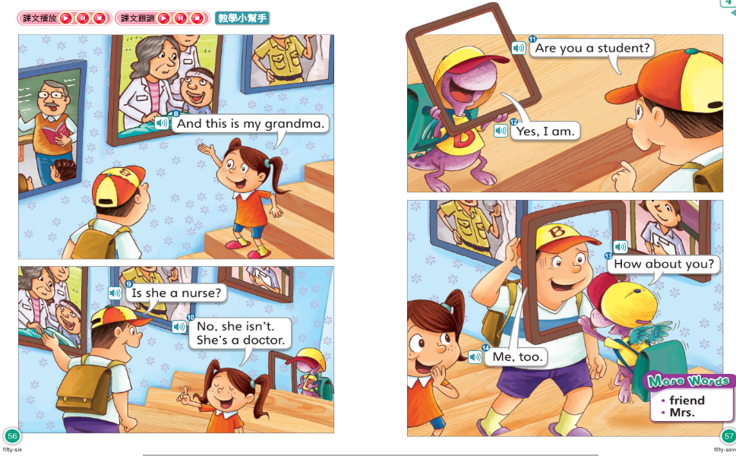
那你呢?
我也是

